Slide 1
Welcome!!
FDP – Cyber Security (SIEM)
Security Information and Event Mgt.

Slide 2
#whoami
Mahesh Pavaskar (SIEM Architect | Cyber Security & Threat Intelligence Engineer)
12,8+ years of Experience
Education : M. Tech VJTI Mumbai
Research + Industry Background
QRadar 7+ years of Experience
Tech talk no - 64
Learning never Ends….
29+ Certification
Cisco Authorized Trainer
BE: Best outgoing Student
Mtech:Student of the Year
Continue………….

Slide 3
Source of knowledge base for FDP & Future
Youtube channel – Free & will be always free
https://www.youtube.com/channel/UCmfJWojrb4UvXqkifBGLu2w
LinkedIn Profile: https://www.linkedin.com/in/mahesh-pavaskar-88068263/
Github
Global link
https://github.com/maheshp1987
SIEM link (Specific to topic)
https://github.com/maheshp1987/SIEM

Slide 4
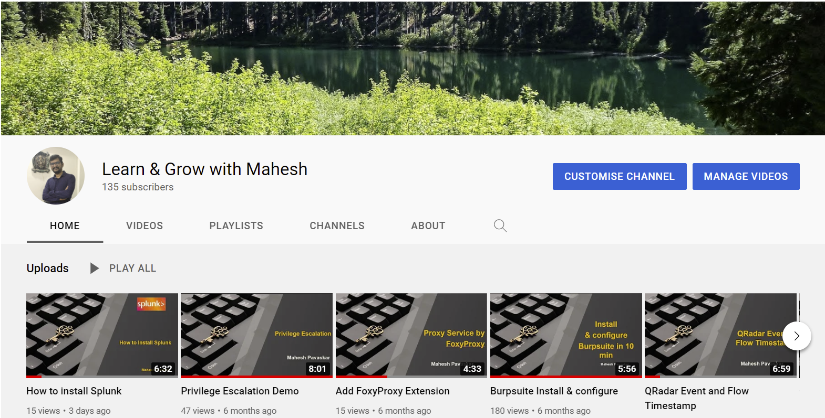
Support & Learn with Me
Youtube channel – Free & will be always free
https://www.youtube.com/channel/UCmfJWojrb4UvXqkifBGLu2w
Channel Name:
Learn & Grow with Mahesh

Slide 5
Focus on SIEM
Antivirus
IDS
IPS
Firewall
EDR
SIEM
Honeypot
Deception Tech
NDR
DLP
Info Security
Cyber Security
Web app Security
Network Security
OS Security
Infra Security etc..

Slide 6
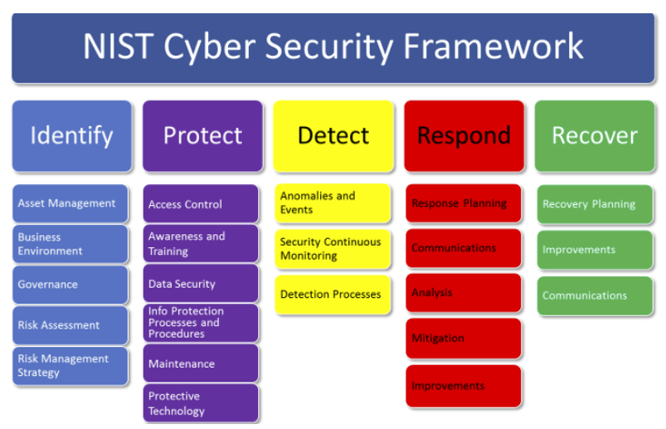
SIEM fits under Detect
https://securityaffairs.co/wordpress/58163/laws-and-regulations/nist-cybersecurity-framework-2.html

Slide 7
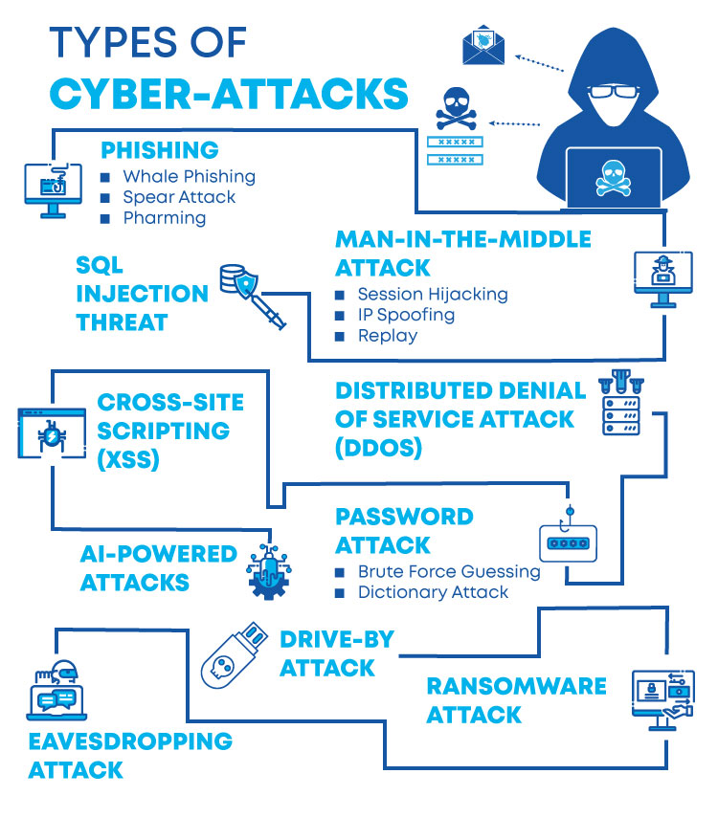
Why Cyber Security needed?

Slide 8
Difference between Info vs Cyber Security
Information Security : Security of Data at rest
Cyber Security : Security of data in-motion or in-transit

Slide 9

The cybersecurity foundation
Security Principles
Confidentiality
Integrity
Availability

Slide 10
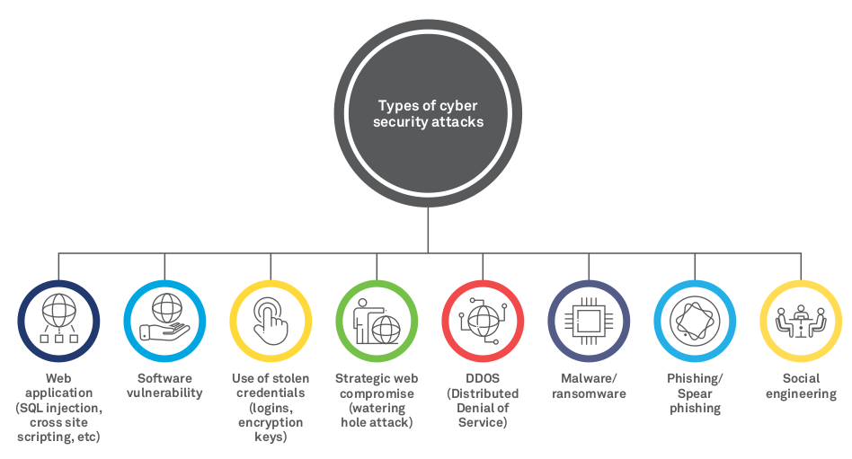
Cyber attack Techniques and Types

Slide 11
Attack Frameworks
MITRE ATT&CK Framework
MITRE CAPEC Framework
NIST
OWASP

Slide 12
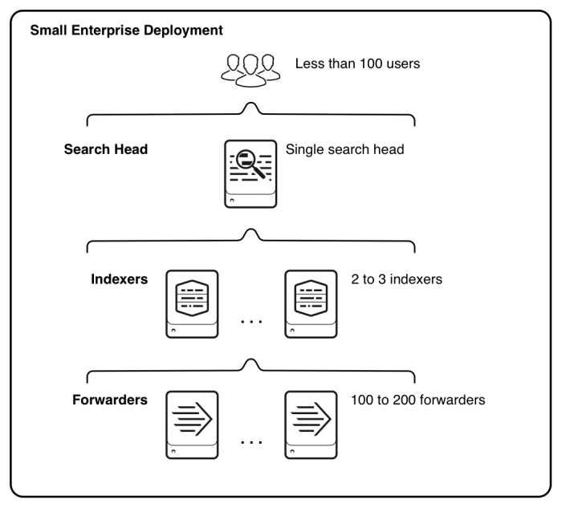
FDP Lab Structure - Splunk
We will use AIO (All-in-one)
60 days trial version splunk

Slide 13
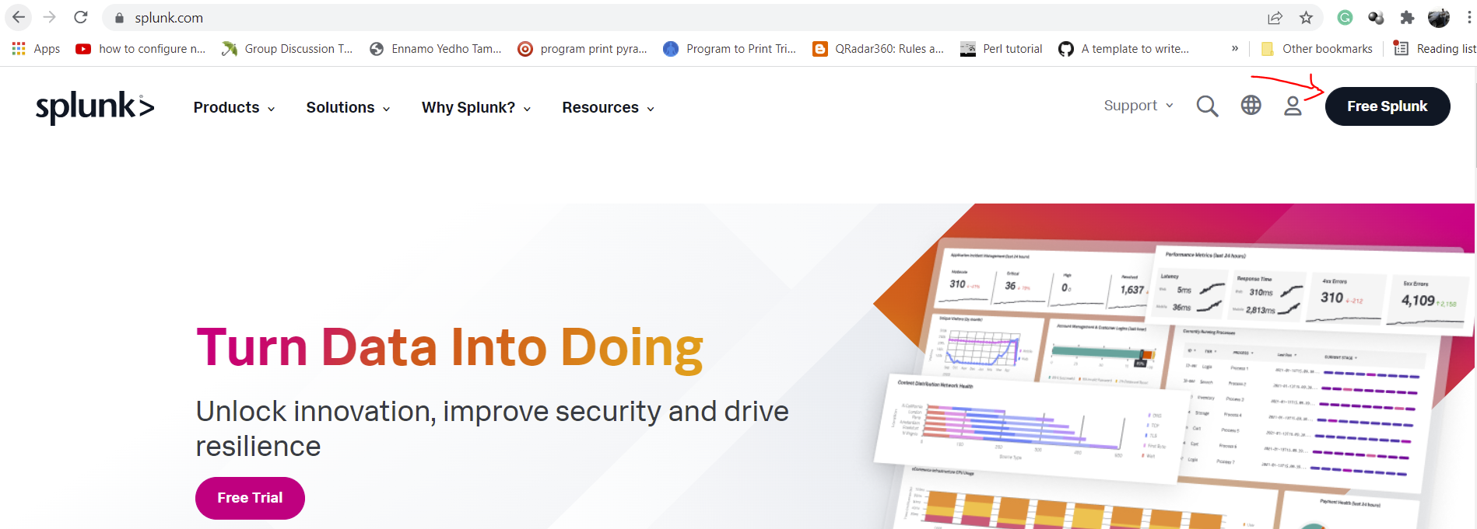
Download Splunk
* Visit www.splunk.com -> Click on Free Splunk -> Create account

Slide 14
Pre-requisites Or Good to have
Success is no accident. ...
Linux
Network
Database
Linux 101 Hacks Book
https://www.thegeekstuff.com/linux-101-hacks-ebook
TCP/IP Protocol Suite
Book by Behrouz A. Forouzan OR PPT
Any database not limited PostgreSQL ..
Revisit DDL, DML and DCL queries.
Information Security
Regular Expression
Important Devices
Study Link
https://regex101.com/
Linux, Windows, Firewall,
Proxies, Router, Application logs etc.
https://www.securitylearningacademy.com/
https://www.youtube.com/user/IBMSecuritySupport

Slide 15
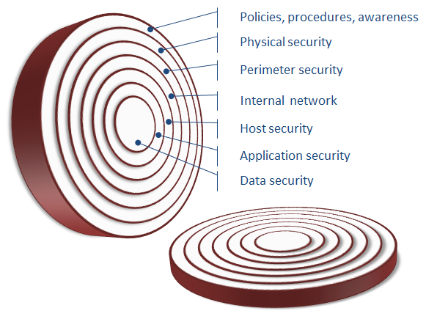
Defense-in-Depth Strategy.
Multilayer defence strategy
Policies , Procedures, Awareness
Non Technical
Because Human is weakest link
2) Physical Security
Access control
Locks
Camera
hello

Slide 16
Defense-in-Depth Strategy.
Multilayer defence strategy
3) Perimeter Security
Firewall, IPS, IDS
Segmentation VLAN
File permission, User access
4) Internal Network
Best practices - Routing Protocol
Control plain policing – Permit & deny filter, QoS filter
Hardening – Disable unwanted services, disable unwanted features.
hello

Slide 17
Defense-in-Depth Strategy.
Multilayer defence strategy
5) Host Security
→ Antivirus
Password policies
Malware protection
VPN – remote access
6) Application Security
Application Robustness
Quality assurance testing
Broken software – open window for attacker
Keep up to date software
hello

Slide 18
Defense-in-Depth Strategy.
Multilayer defence strategy
7) Data Security
Encryption
Backup
Monitor
hello

Slide 19
ERIN
E : Events
R : Rules
I : Incidents
N : Notification
Note : Right person should get notification about the incident via
Email
Ticketing system : using API
BMC remedy, Service now, Jira, IBM Resilient etc.
Normally when incident occurs
L1 team → L2 Team → L3 / CIRT Team

Slide 20
Why SIEM?

Slide 21
Why SIEM needed?
Gather information at one place and help to monitor security posture of organisation
Detect suspicious behaviour
Detect problems before they become breaches
Monitor & enforce corporate policies
Reports : Regulatory compliances – PCI, HIPAA etc

Slide 22
What SIEM / QRadar does?
Main functions
Collect logs from different endpoints like Firewall, IDS/IPS, AD, Antivirus, Wireless controller, Linux servers, windows servers, proxies etc.
Logging and reporting
→ Log user access
→ Track system changes
→ Monitor corporate policies and alert if policy violation happens
→ Provide reports for audit purpose
C) Correlation and Cross-correlation
→ Combine data from different sources
→ Identify Hidden threats
→ Reduce false positives
D) Real time alert generation.

Slide 23
What is SIEM (SIM + SEM)
SIEM – Security Information / Incident & Event Management
SIEM acronym is ”sim”
SIEM tools provides real time alerts or risk to organization.
In market there are so many SIEM products like
A) IBM QRadar
B) Arcsight
C) LogRhythm
D) Splunk etc……

Slide 24
Question?
Is Firewall, IDS, IPS, Antivirus are enough to protect malware?
Yes ?%
No ?%

Slide 25
Are you secure / compromised ?
Once you infected then attacker can
Remote control
Data extraction
Remote monitoring
Data destruction
Privilege escalation
Remote attack
Ransomware
Firewall, IDS/IPS, Antivirus not
Enough to protect from malware
Or from advance threats

Slide 26
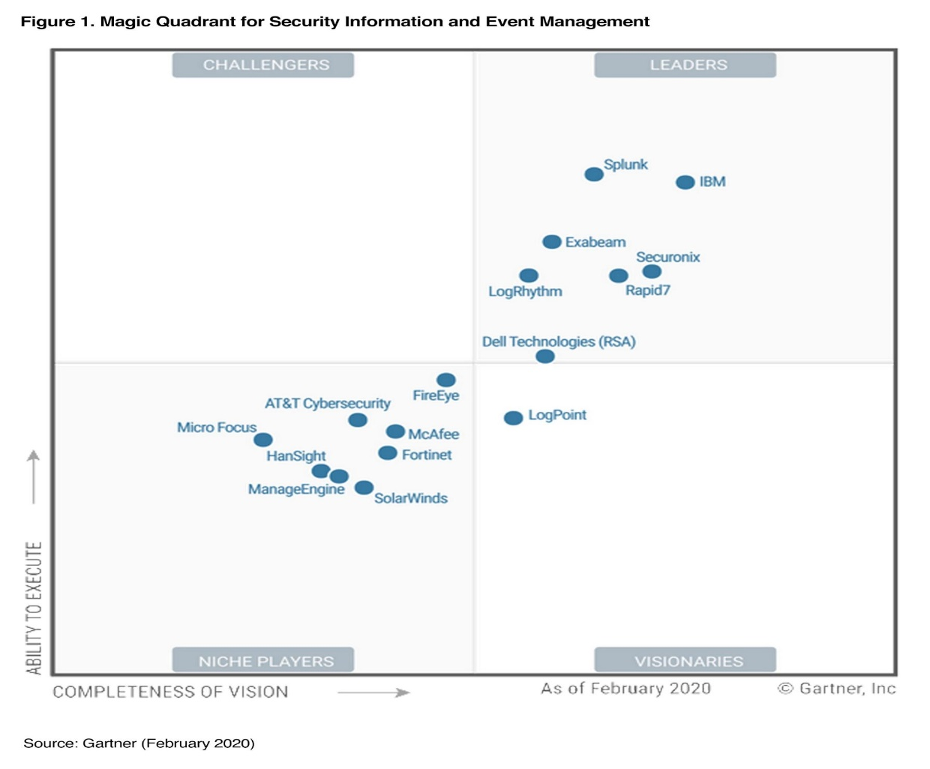
SIEM Vendors – Gartner
SIEM Leaders:
IBM Qradar
Splunk
Securonix SNYPR
Exambeam etc

Slide 27
Roles
Splunk / Qradar is just product so focus on domain knowledge
Analyst
Admin
Engineer / Architect
Create Playbook
Investigate Offense
Generate Offense
Request to tune rule
Daily SOC tasks
Create Use cases
Create rules
On-board Log sources
Create Users / accounts
Manager QRadar Application
Customization if required
Design architecture & Deploy
Manage Infrastructure
Scale Up Environment
Health Monitor
Patch request / upgrade

Slide 28
Designation / Job Titles in Security Area
Analyst L1
Senior Analyst L2
Lead Analyst / Level 3
QRadar Admin
Content Development Engineer
Operational Engineer
Professional services
QRadar Engineer / Architect
Vulnerability Manager
SOC Manager
Cyber Security Director
CIRT L1
CIRT L2
CIRT Manager
Red team
Blue team
Penetration tester
Web Penetration tester
Wireless Penetration tester
Network Security Engineer
Network Security Analyst

Slide 29
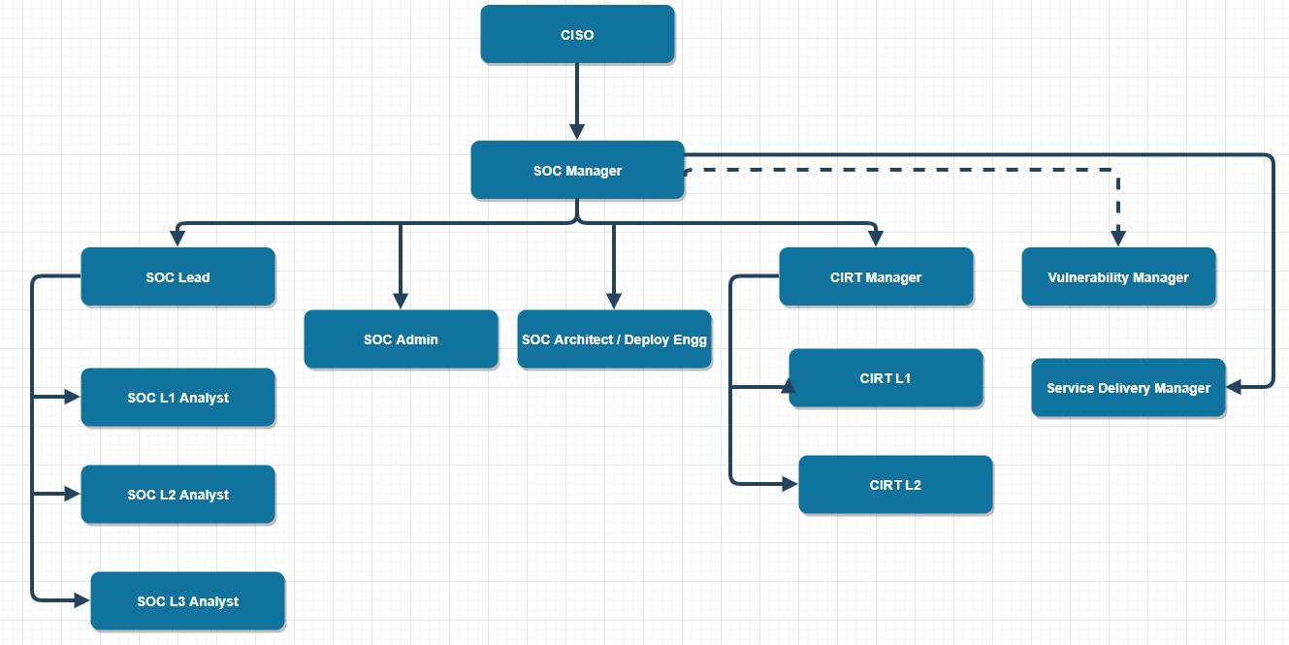

Slide 30
Important Certification
CEH / Security +
CCNA / Network +
RHCSA
RHCE
CompTIA Certifications (https://certification.comptia.org/certifications)
CISSP
OSCP
OSCE
CISM
CISA
CCSP

Slide 31
ERIN
E : Events
R : Rules
I : Incidents
N : Notification
Note : Right person should get notification about the incident via
Email
Ticketing system : using API
BMC remedy, Service now, Jira, IBM Resilient etc.
Normally when incident occurs
L1 team → L2 Team → L3 / CIRT Team

Slide 32
QRadar Source of Information.
Log sources
Assets Information
OS, Firewall, Proxy, Databases
Asset weight, Network hierarchy, manual info.
Flow sources
Threat Intelligence
Network listening, Net flow, Qflow
IBM X-force, Threat grids etc
Vulnerability Scans
Reference watch list
Qradar VM, Third party scanner like nessus, nCircle etc
HR feeds, Blacklisted, Manual input..

Slide 33
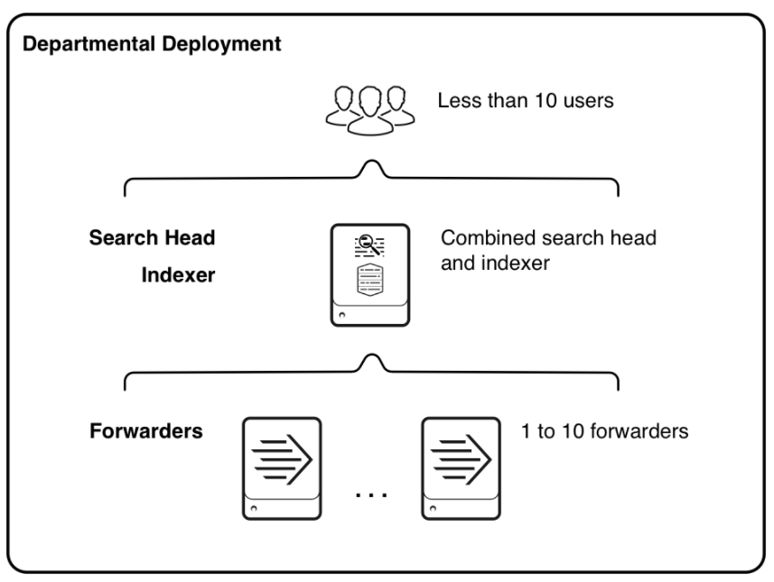
Splunk Architecture
3 IMP components:
Forwarders
Indexer
Search Head

Slide 34
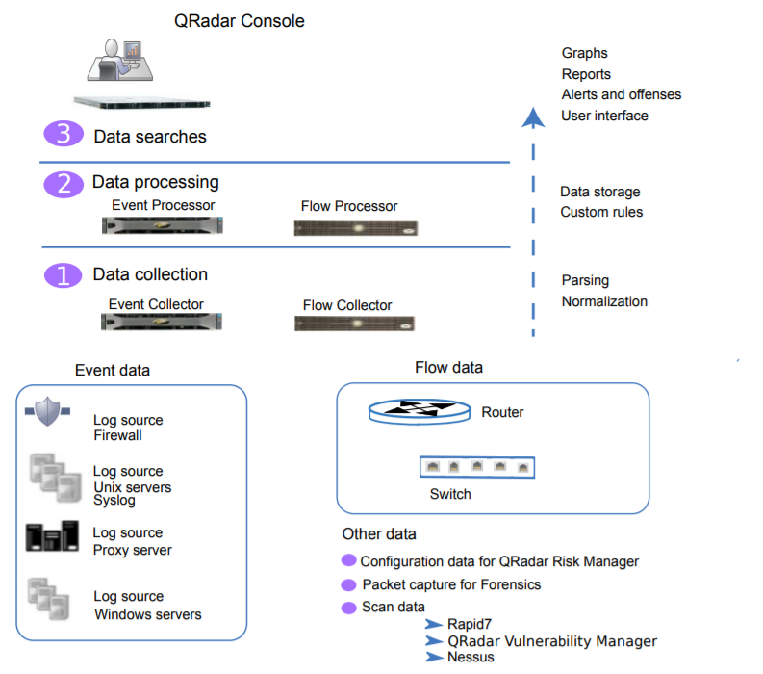
QRadar Architecture
Ref: IBM Arch & Deployment guide

Slide 35
What is log source
A log source is a data source that creates an event log.
For example,
Linux
Windows
AD
Proxy – Cisco iornport or bluecoat
WAF – Imperva
Log Source : The endpoints from which we collect logs OR A log source is any external device, system, or cloud service that is configured to either send events to SIEM system or to be collected by your SIEM system using pull.

Slide 36
Methods to Collect logs
Types to collect logs in QRadar
To receive raw events from log sources, QRadar supports many protocols.
Push Method : QRadar listen for events on specific ports.
For example Linux OS sends logs towards QRadar on port 514 using syslog/ rsyslog / syslog-ng.
Pull Method : use APIs or other communication methods to connect to external systems that pull and retrieve events.
Example 1: In some cases like custom application logs we need to poll logs from endpoint using Log file i.e using SCP, SFTP etc.
Example 2: Suppose we need to collect logs using API after 10 min interval.

Slide 37
Install Splunk

Slide 38
Ingestion of sample logs

Slide 39
Reach out to us
Whatsapp - +91 8087114770
Mail me at pavaskarmahesh@gmail.com

Slide 40
Thank you

